Slide 1
New Coffee shop in Brussels

Slide 2
Intro/Business problem
Coffee addict & enterepreneur
Where to start a new coffee shop
Not a lot of others in the surrounding area
In the city center of Brussels

Slide 3
Data
FourSquare API
Location of Brussels City Center (Geocoder)

Slide 4
Data tools & libraries
Folium: mapping of the locations
Pandas & Numpy: edit data
Geocoder: Retrieve lcoation data
JSON: handle API results
Request: make call to the API

Slide 5
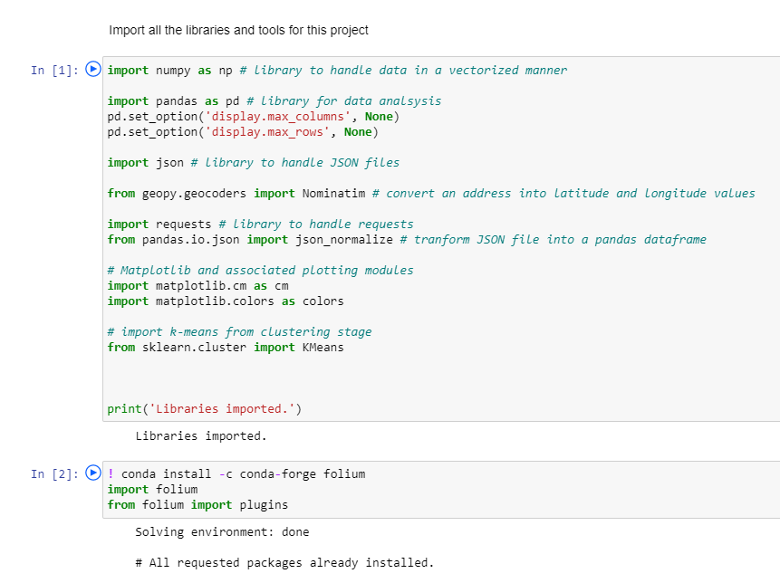
Methodology: the start

Slide 6
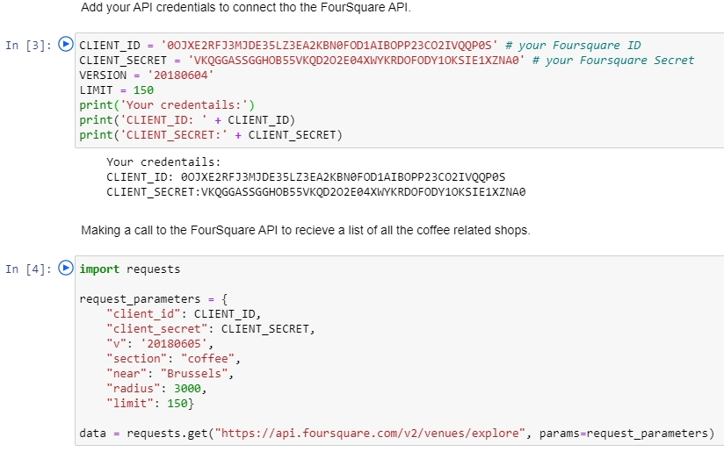
API call

Slide 7
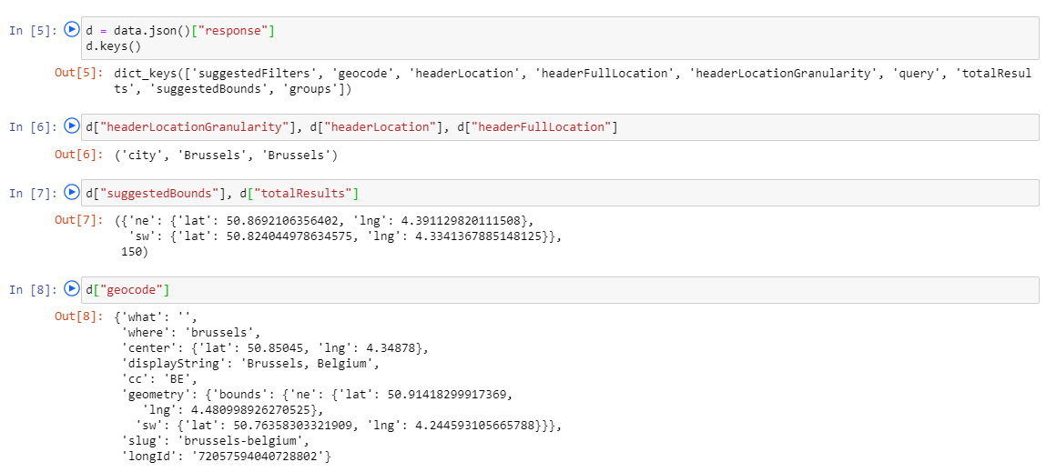
Edit the response

Slide 8
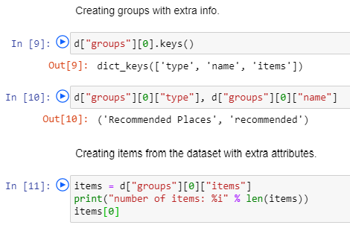
Create groups and items from dataset

Slide 9
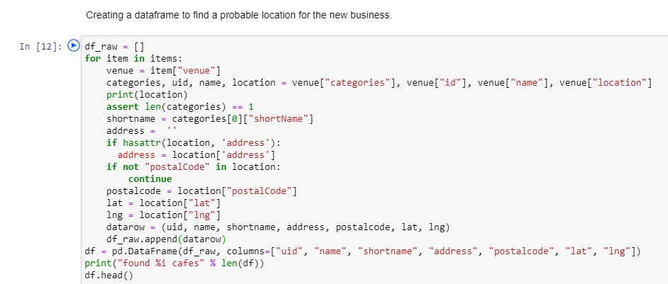

Slide 10
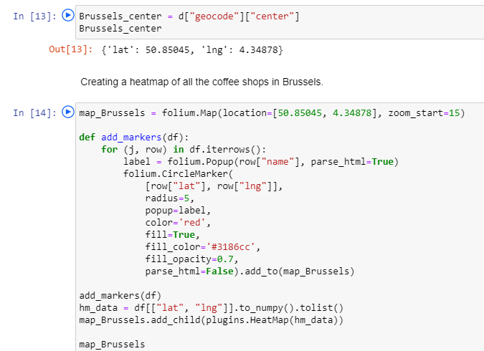
First heatmap

Slide 11
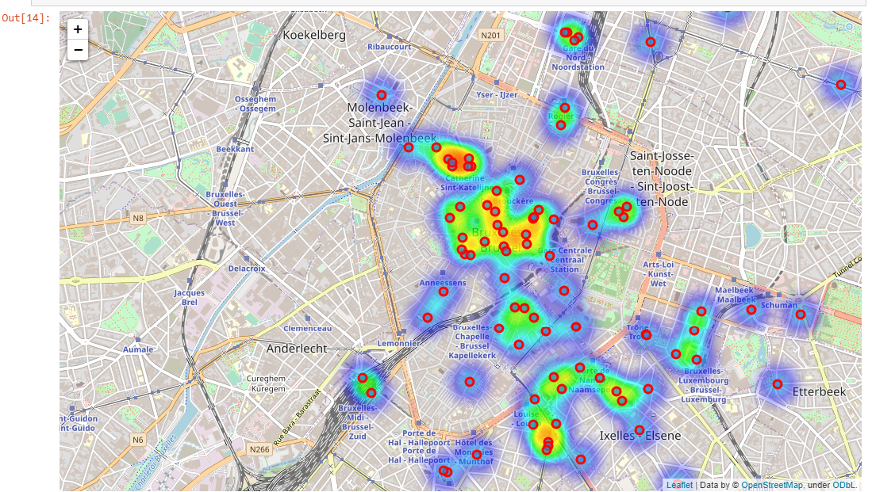

Slide 12
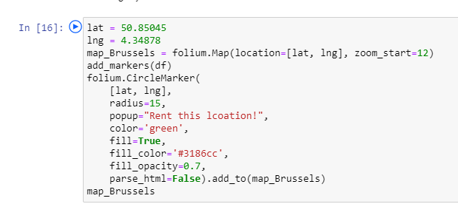
Second map

Slide 13
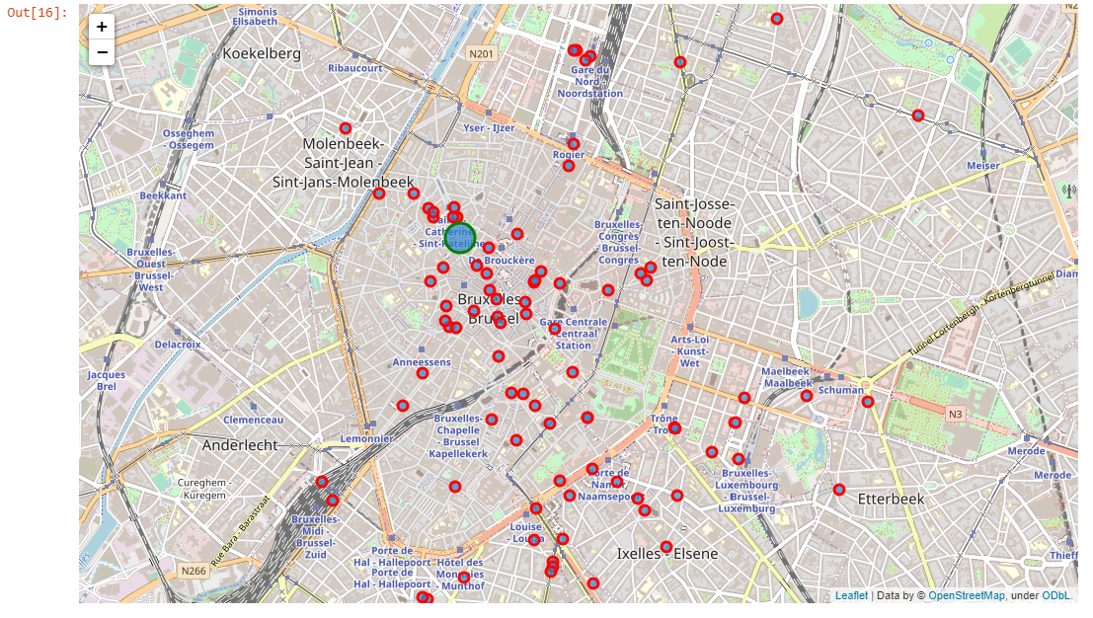

Slide 14
Result

Slide 15
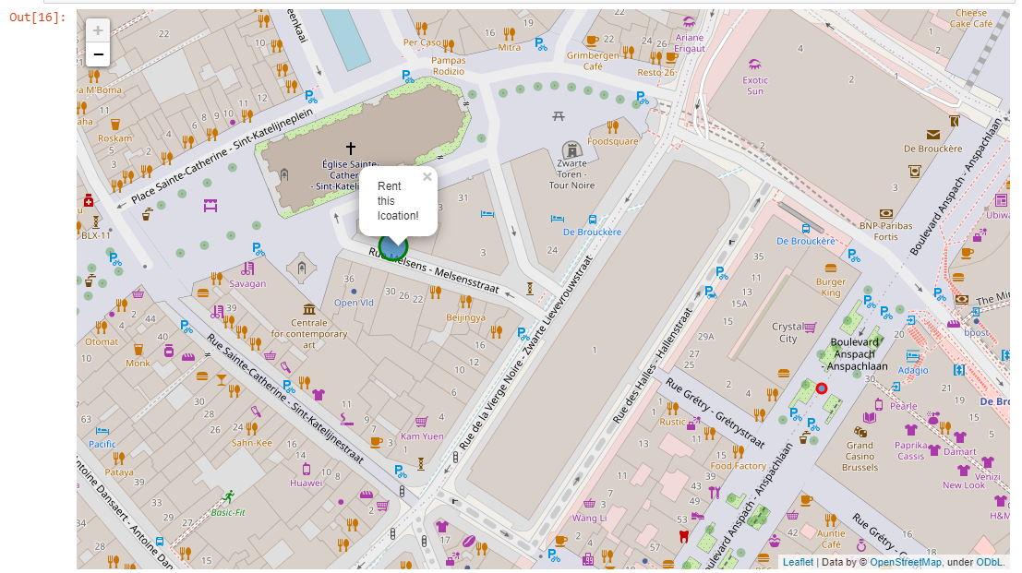
The perfect location!

Slide 16

Discussion
More data would make it more accurate
Room for improvement, but good proof of concept that works with this data source!

Slide 17
Conclusion
There can never be enough coffee shops in a big city! I am happy that I found an extra place to start another one.
This proof of concept was very fun to make and tinker around with. This will centainly not be my last project. I will keep working with differente techniques to make more accurate and other interesting models.

